Slide 1

Project 1 How to read Image and Video in Python

Slide 2

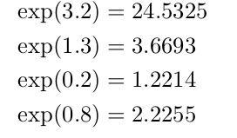
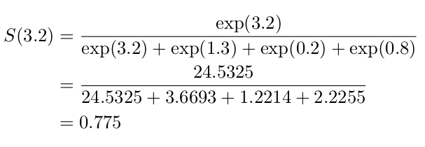
Example

Slide 3
